Slide 1
Symmetric Matrices and Quadratic Forms

Slide 2

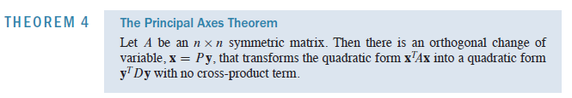


Slide 3
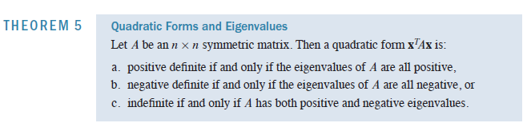
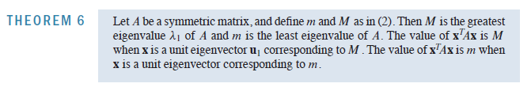
CONSTRAINED OPTIMIZATION

Slide 4
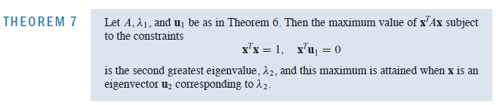
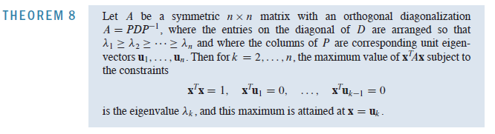
CONSTRAINED OPTIMIZATION

Slide 5
singular value decomposition

Slide 6


Introduction
The absolute values of the eigenvalues of a symmetric matrix A measure the amounts that A stretches or shrinks certain vectors (the eigenvectors)
Example

Slide 7


example

Slide 8


Singular Values

Slide 9
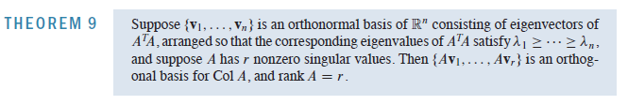

Theorem
Col A

Slide 10
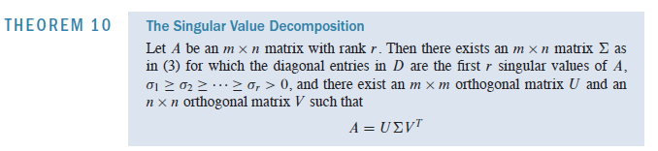

SVD
matrices U and V are not uniquely determined by A, but the diagonal entries of D
are necessarily the singular values of A
columns of U left singular vectors of A
columns of V right singular vectors of A

Slide 11



proof

Slide 12
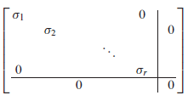

proof

Slide 13







example

Slide 14


example
Gram-Schmidt

Slide 15







example

Slide 16




SVD for Image Compression
Redundancy exists in Images
Size of images
Compression

Slide 17

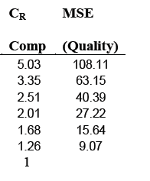
SVD for Image Compression
To measure the quality between original image A and the compressed image Ak, the
measurement of Mean Square Error (MSE)

Slide 18


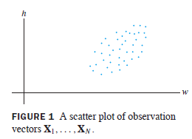


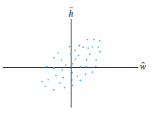
Principle Component Analysis

Slide 19




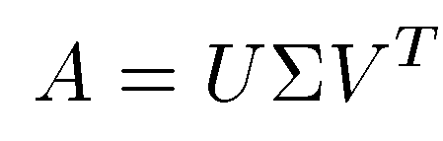
PCA Approach for Face Recognition
SVD approach treats a set of known faces as vectors in a subspace, called “face space”
Assume each face image has m × n = M pixels
an M × 1 column vector fi
A training set, S with N number of face images of known individuals forms an M × N matrix:

Slide 20



PCA Approach for Face Recognition
Minimize the distance

Slide 21
